Slide 1
Key Findings
@INS_cameroun #CameroonMIS #CamerounEIP

Slide 2
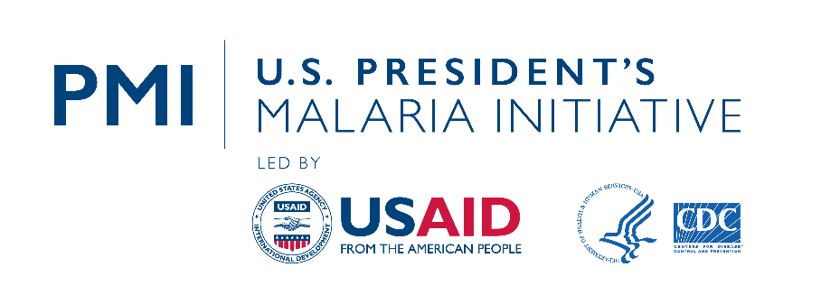


The Malaria Indicators Survey Cameroon 2022 (CMIS 2022) was implemented from August 22 to December 1, 2022 by the Institut National de la Statistique (INS) in close cooperation with the National Malaria Control Program (NMCP). Financial support for the MIS-Cameroon 2022 was provided by the United States Agency for International Development (USAID) through the US President’s Malaria Initiative (PMI), the Government of Cameroon, the Global Fund to Fight AIDS, Tuberculosis and Malaria (The Global Fund). ICF provided technical assistance through the DHS Program, a USAID-funded project providing support and technical assistance in the implementation of population and health surveys in countries worldwide.
The contents of this presentation are the sole responsibility of INS, NMCP, and ICF and do not necessarily reflect the views of USAID, the United States Government, or other donor agencies.

Slide 3
The Survey
The CMIS 2022 is the first Malaria Indicator Survey conducted in Cameroon as part of The DHS Program.
It is designed to provide estimates at the national level, by residential areas (Yaoundé/Douala, other urban, and rural areas), and at the 12 regional levels.

Slide 4
Sample Design
Sampling Frame: General Census of Population and Housing in 2017-18 by the Central Bureau of Population Censuses and Studies
First Stage: 470 enumeration zones from 6,580 households (3,598 in 263 urban clusters and 2,982 in 207 rural clusters)
Second Stage: 14 households per cluster were selected.
Selected households were visited and interviewed.
All women age 15-49 in all selected households were eligible for interview; children age 6-59 months were eligible for malaria and anaemia testing.

Slide 5
Pretest and Main Survey Training
Pretest Training:
Training for 12 interviewers and 4 lab techs from May 31 to June 14, 2022 under the guidance of 15 supervisors/trainers. Activities included 10 days of staff training, 3 days of field practice, and 2 days of debriefing.
Main Survey Training:
  111 participants trained from August 2 – 20, 2022.
  Training was organized into 3 workshops:
    French-speaking participants for positions of survey agents, monitors, and team leaders
    English-speaking participants for positions of survey agents, monitors, and team leaders
    Lab techs in charge of biomarker testing

Slide 6
Fieldwork and Data Processing
Data collection took place from August 22 to December 1, 2022.
18 teams included:
  1 team leader, 2 interviewers, 1 lab tech, and 1 driver
Interviews were conducted with tablets, and data entry and editing were done with CSPro.

Slide 7
Results of Household and Individual Interviews
Household Interviews
Households selected | 6,290
Households occupied | 6,080
Households interviewed | 6,031
Response rate | 99%
Interviews with Women age 15-49
Eligible women | 6,647
Women interviewed | 6,532
Response rate | 98%

Slide 8

Drinking Water Service by Residence
Percent distribution of household population by drinking water service ladder
Indicators 1.4.1, 6.1.1
Figures ≠ 100% due to rounding.
Notes:
Three-quarters of household populations have at least basic service for drinking water.
Limited service = Drinking water from an improved source, provided round-trip collection time is >30 minutes or is unknown.
At least basic service = Drinking water from an improved source, provided either water is on the premises or round-trip collection time is <30 minutes. Includes safely managed drinking water.

Slide 9
Sanitation Service Ladder by Residence
Percent distribution of household population by type of sanitation service
Indicators 1.4.1, 6.2.1
Figures ≠ 100% due to rounding.
Notes:
Nearly half of the household population has access to at least basic sanitation services.
Note: Service ladder concept/definitions based on the WHO/UNICEF Joint Monitoring Programme for Water Supply, Sanitation, and Hygiene (JMP).
¹ Use of flush/pour flush toilet not to sewer, septic tank, or pit latrine, pit latrines without a slab/open pit, hanging toilets/latrines, or buckets
² Defined as use of improved facilities shared by 2 or more households
³ Defined as use of improved facilities that are not shared with other households. Includes safely managed sanitation service, which is not shown separately.
Table 2.4

Slide 10
Electricity by Residence
Indicator 7.1.1
Percent of household population with electricity:
Notes:
Overall, about 2 of 3 household population has access to electricity. Electricity is more common in urban areas (97% in Yaoundé and Douala and 80% in other urban areas) than in rural areas, where only 35% have access to electricity.
Table 2.6

Slide 11
Women’s Education
Percent distribution of women age 15-49
Figures ≠ 100% due to rounding.
Notes:
20% of women have no education. 25% of women have primary education, 44% have completed secondary education, and 12% have more than secondary education.
Table 2.14

Slide 12
Literacy
Percent of women age 15-49 who are literate
Notes:
Overall, 2 in 3 women are literate, while less than half of women in rural areas are literate.
Table 2.15

Slide 13
Insecticide-treated Net (ITN) Ownership
Percent of households with at least one ITN and percent of households with:
Notes:
75% of households own at least 1 mosquito net; 72% own at least one ITN.
Table 3.1

Slide 14
ITN Ownership by Region
Percent of households with at least one ITN
Cameroon
72%
Far North 97%
North 94%
Northwest 66%
Adamawa 91%
Southwest 59%
West 59%
Centre 55%
Littoral 71%
East 64%
Douala 68%
Yaoundé 56%
South 68%
Notes:
The percentage of households with at least one ITN is highest in the Far North (97%), North (94%), and Adamawa (91%) regions, and lowest in the Centre (55%), Yaoundé (56%), West (59%) and South-West (59%) regions.
Table 3.1

Slide 15
Trends in ITN Ownership
Percent of households with at least one ITN and percent of households with at least one ITN
for every two people in the household
1+ ITN
1+ ITN for every 2 people
In DHS surveys in Cameroon until 2011, the definition of an ITN included nets that had been soaked in an insecticide against mosquitoes within the previous 12 months. Since 2011, all mosquito nets distributed are Long-Lasting Treated Nets (LLINs).
Notes:
Ownership of ITNs increased a great deal between 2004 and 2018, with little change since.

Slide 16
Source of ITNs
Percent distribution of ITNs in interviewed households by source of net
Total ≠ 100% due to rounding
Notes:
The vast majority of ITNs in households were received during mass distribution campaigns.
Table 3.2

Slide 17
Household Coverage of ITNs
Percent distribution of households
Total ≠ 100% due to rounding
Notes:
Nearly half of households have at least 1 ITN for every 2 people in the household. 3 in 10 households have no ITNs.

Slide 18
ITN Access and Use
Percent of household population with access to an ITN and percent who slept under an ITN the night before the survey
Notes:
Overall, 64% of the household population has access to ITNs and 54% slept under an ITN the night before the survey. ITN access and use are higher in rural areas than in urban areas including Yaoudé and Douala.
Tables 3.3, 3.4, 3.8

Slide 19
Trends in ITN Access and Use
Percent of household population with access to an ITN and percent who slept under an ITN the night before the survey
Access to an ITN
Slept under an ITN
In DHS surveys in Cameroon until 2011, the definition of an ITN included nets that had been soaked in an insecticide against mosquitoes within the previous 12 months. Since 2011, all mosquito nets distributed are Long-Lasting Treated Nets (LLINs).
Notes:
Between 2004 and 2022, the percentage of the household population with access to an ITN increased a great deal, from 1% in 2004 to 64% in 2022. Similarly, the percentage of the population who slept under an ITN the night prior to the interview rose from 1% to 54% over the same period.

Slide 20
Use of ITNs
Percent who slept under an ITN
the night before the survey among
all households
Percent who slept under an ITN
the night before the survey among
households with at least one ITN
Notes:
58% of children under age 5 in all households slept under an ITN the night prior to the interview. In households with at least one ITN, the figure was 69%. Among pregnant women in all households, 63% slept under an ITN the night before the interview, and in households with at least one ITN, 79% of women slept under an ITN.
Tables 3.6, 3.7

Slide 21
Children’s Use of ITNs by Region
Percent of children under age 5 who slept under an ITN the night before the survey
Cameroon
72%
Far North 83%
North 73%
Northwest 40%
Adamawa 62%
Southwest 43%
West 33%
Centre 42%
Littoral 60%
East 42%
Douala
56%
Yaoundé 48%
South 53%
Notes:
The percentage of children under age 5 who slept under an ITN the night before the survey was highest in Far North (83%) and North (73%) regions, and lowest in West (33%), Centre (42%), and East (42%) regions.
Table 3.6

Slide 22
Trends in ITN Use among Children and Pregnant Women
Percent of children under age 5 and pregnant women age 15-49 who slept under an ITN the night before the survey
Pregnant women
Children under age 5
In DHS surveys in Cameroon until 2011, the definition of an ITN included nets that had been soaked in an insecticide against mosquitoes within the previous 12 months. Since 2011, all mosquito nets distributed are Long-Lasting Treated Nets (LLINs).
Notes:
Between 2004 and 2022, there has been a great increase in ITN use among children under age 5 (1% to 58%) and pregnant women (2% to 63%).
Tables 3.6, 3.7

Slide 23
Intermittent Preventive Treatment during Pregnancy (IPTp)
Percent of women age 15-49 with a live birth in the two years before the survey who received:
Notes:
8 in 10 women received one or more doses of intermittent preventive treatment during pregnancy; nearly half received 3 or more doses.
Table 3.13

Slide 24
Trends in IPTp
Percent of women age 15-49 with a live birth in the two years before the survey who received:
IPTp1+
IPTp2+
IPTp3+
Notes:
Between 2004 and 2022, the percent of women who took one or more doses of intermittent preventive treatment rose drastically (1% to 83%).

Slide 25
Fever in Children
Percent of children under age 5 with fever in the 2 weeks before the survey
Percent of children under age 5
Notes:
1 in 3 children under age 5 had fever in the 2 weeks before the survey; advice or treatment was sought for half of those children and blood was for testing from about 1 in 4 of those children.
Table 4.1

Slide 26
Type of Antimalarial Drugs
Among children under age 5 with fever in the 2 weeks before the survey who took an antimalarial, percent who took:
Notes:
Of children under age 5 with fever in the 2 weeks before the survey, nearly half took any ACT.
Table 4.8

Slide 27
Prevalence of Low Haemoglobin in Children by Age
Percent of children age 6-59 months with moderate-to-severe anaemia (haemoglobin < 8.0 g/dl)
Age in months
Notes:
Overall, 6% of the children tested had low hemoglobin. Children at 12-17 months had the highest prevalence at 11%.
Table 4.10

Slide 28
Prevalence of Low Haemoglobin by Wealth
Percent of children age 6-59 months with moderate-to-severe anaemia (haemoglobin < 8.0 g/dl)
Poorest households
Wealthiest households
Notes:
The prevalence of low haemoglobin is higher among children in the poorest households than among those in the wealthiest households.
Table 4.10

Slide 29
Prevalence of Malaria by Region
Percent of children age 6-59 months who tested positive for malaria by RDT
Cameroon
26%
Far North 27%
North 29%
Northwest 11%
Adamawa 31%
Southwest 30%
West 19%
Centre 49%
Littoral 28%
East 41%
Douala 7%
Yaoundé 10%
South 46%
Notes:
The regions with the percent of children who tested positive for malaria are highest in Centre (49%), South (46%), and East (41%).
Table 4.11

Slide 30
Trends in Prevalence of Low Haemoglobin
Percent of children age 6-59 months with moderate-to-severe anaemia (haemoglobin < 8.0 g/dl)
Notes:
The prevalence of low haemoglobin among children has declined from 2004 (11%) to 2022 (6%).

Slide 31
Malaria Prevalence by Residence
Percent of children age 6-59 months who tested positive for malaria by RDT
Notes:
In Yaoundé and Douala, the prevalence is only 8%, but in the rural regions, 1 of 3 children tested positive.
Table 4.11

Slide 32
Malaria Prevalence by Age
Percent of children age 6-59 months who tested positive for malaria by rapid diagnostic test (RDT)
Age in months
Notes:
1 in 4 children tested positive for malaria. Prevalence increases from the age of 24 months.
Table 4.11

Slide 33
Malaria Prevalence by Wealth
Percent of children age 6-59 months who tested positive for malaria by RDT
Poorest households
Wealthiest households
Notes:
Malaria prevalence is highest among those in the poorest households and lowest among those in the wealthiest households.
Table 4.11

Slide 34
Prevalence of Malaria by Region
Percent of children age 6-59 months who tested positive for malaria by RDT
Cameroon
26%
Far North 27%
North 29%
Northwest 11%
Adamawa 31%
Southwest 30%
West 19%
Centre 49%
Littoral 28%
East 41%
Douala 7%
Yaoundé 10%
South 46%
Notes:
The regions with the percent of children who tested positive for malaria are highest in Centre (49%), South (46%), and East (41%).
Table 4.11

Slide 35
Knowledge of Ways to Avoid Malaria by Education
Percent of women age 15-49 who know there are ways to avoid malaria
Notes:
Overall, 9 of 10 women know that there are ways to avoid malaria. 8 in 10 women with no education know at least one way to avoid malaria, compared to nearly all women with more than secondary education.
Table 5.2

Slide 36
Knowledge of Ways to Prevent Malaria
Percent of women age 15-49 who cite specific ways to avoid malaria
Notes:
Nearly all the interviewed women cited sleeping under an MII as a method to avoid malaria.
Table 5.2

Slide 37
Exposure to Malaria Messages by Residence
Among women age 15-49, percent who have seen or heard a message about malaria in the past 6 months
Notes:
Overall, more than half the women heard or saw a message about malaria during the last 6 months. That number varies only slightly by residence.
Table 5.1.1

Slide 38
Source of Malaria Messages
Among women age 15-49 who saw or heard a malaria message in the last six months, percent citing specific sources for malaria messages
Notes:
The most common source of malaria messages is healthcare workers (31%), followed by parents and family (30%) and television (27%).
Table 5.1.1

Slide 39
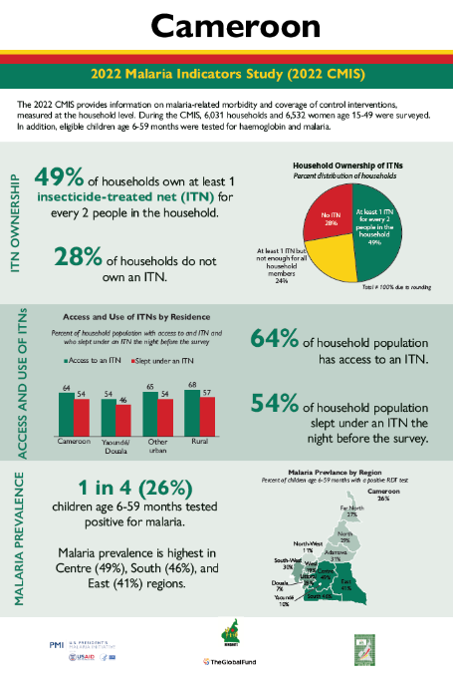
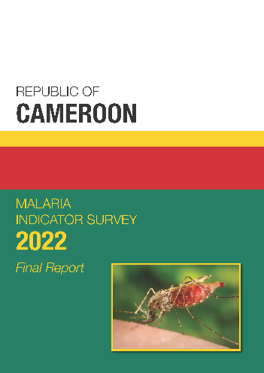
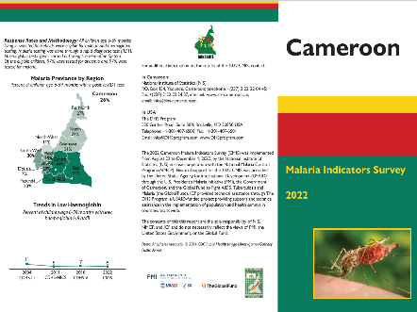
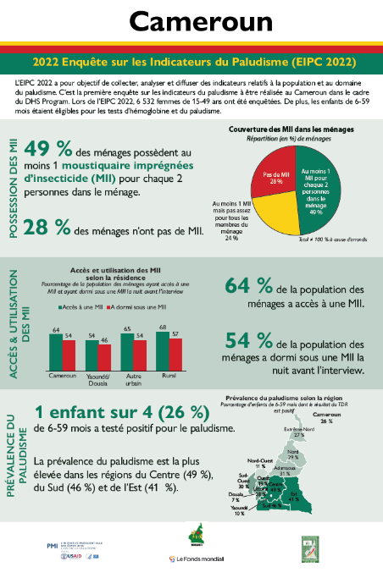
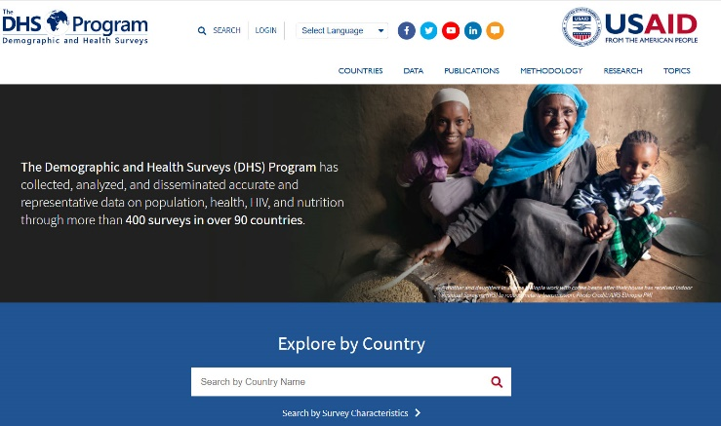
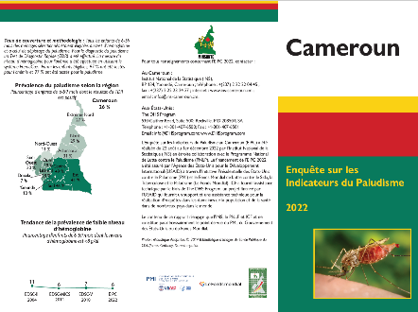
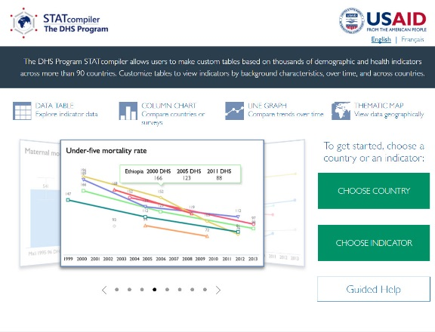
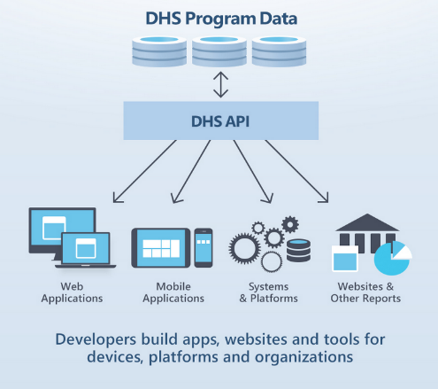
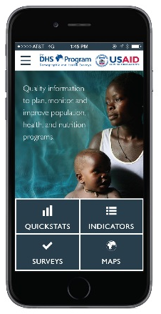
CMIS 2022Publications, Data, and Digital Tools
Final Report
(French & English)
Fact Sheets
(French & English)
Infographic
(French & English)
Dataset available at DHSprogram.com
STATcompiler.com
API.DHSprogram.com
DHS Program Mobile App for Android & iOS
Notes:
Please note that all materials, digital tools and datasets with MIS-C 2022 data will be made publicly available online within 1 day following the National Seminar. Print materials will be available from INS.

